Slide 1
ORGANIZATION NAME : CDK Global PROBLEM CODE : RA28
PROBELM STATEMENT : Crop Guidance and Farmers Friend COLLEGE CODE : 2718
TEAM NAME : TEAM INCOGNITO
TEAM LEADER NAME : SHARANG RAMANA G
SOLUTION / IDEA :
The android application enables an user interactive platform for farmers to manage ,visualize and analyse the data from fields based on specific crop and location (using GIS tools). This software intends to display the requirements of the crop production in the form of graphs or maps which indicates the crop’s health, yield, market price, soil fertility, disease spread, crop growth which in turn helps the agrarian for better farming. This software provides the precision idea for the budding farmers about the farm and renders beneficial yield.
TECHNOLOGY STACK :
HTML5
CSS3
Java Script
Django
Bootstrap
Sq3 Lite
Postgres
Map box Studio
ArcGIS
OSM files
Firebase
Tensor flow
Android Studio

Slide 2
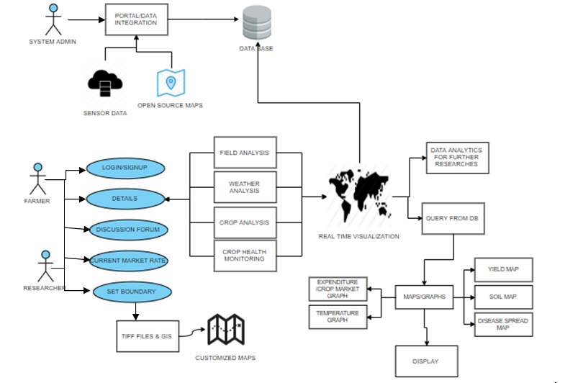
USE-CASE:
DEPENDANCIES:
Accurate results can be given only if readings are taken at multiple points of the field.
The calculations should be taken periodically for accurate results.

